Slide 1
Welcome to Fifth Grade Curriculum Night
Virtual Learning 2020

Slide 2
We’re glad you’re here!
We are excited to welcome you all to a new school year!
The 2020-2021 school year will be exciting, challenging, and full of new friends and new experiences.
We look forward to working with you to make the Wadsworth virtual learning experience as smooth, effective, and enjoyable as it can possibly be.
NOTE – This PowerPoint will be available for your future reference. on each teacher's webpage.

Slide 3
Administration and office
Principal, Ms. Jemison Ledra_Jemison@dekalbschoolsga.org
Assistant Principal, Dr. Jones gloria_jones@dekalbschoolsga.org
Administrative Assistant, Ms. Lynch Michele_Lynch@dekalbschoolsga.org
Bookkeeper, Ms. Jones Lashandria_Jones@dekalbschoolsga.org

Slide 4
Fifth Grade Team – Teachers/Support
Mrs. Berry, ELA
Ariel_S_Berry@dekalbschoolsga.org
Mrs. McNabb, Math/ELA
sharon_s_mcnabb@dekalbschoolsga.org
Ms. Sanders, Science/ELA melissa_c_sanders@dekalbschoolsga.org
Ms. Roseberry, Social Studies
mkatherine_roseberry@dekalbschoolsga.org
Coach Jackson, P.E. Don_Jackson@dekalbschoolsga.org
Dr. Hayes, Drama Will_D_Hayes@dekalbschoolsga.org
Mrs. Natal, Spanish miriam_natal@dekalbschoolsga.org
Mr. Coln, Strings robert_coln@dekalbschoolsga.org
Mr. Fowler, Band carlos_d_fowler@dekalbschoolsga.org
Ms. Kelly Schroeder, Art kelly_b_schroeder@dekalbschoolsga.org
Nurse, Ms. Handy Regina_Handy@dekalbschoolsga.org
Counselor, Mr. Barnes Charles_Barnes@dekalbschoolsga.org
Media Specialist, Mrs.HannaJessica_Elswick@dekalbschoolsga.org

Slide 5
Virtual Learning Expectations
Before Classes
During Classes
After Classes
Complete meals and use the restroom.
Read any announcements from the teachers.
Find a QUIET area at home – Virtual Learning Space.
Gather all materials needed for class.
Make sure Chromebook is charged and ready.
Join live sessions with video on and mic muted.
Give class your full attention – no music, tv, games, or videos.
Participate in all class activities.
Do not leave the virtual classroom without permission.
Inform the teacher IMMEDIATELY if something prevents you from participating. (i.e. "My screen froze.")
Complete asynchronous/individual assignments within the given time frame.
Message a classmate or the teacher ASAP if you need help.
Return all school materials to their proper places so that you can find them tomorrow.
Charge your Chromebook so it will be ready for the next day.

Slide 6
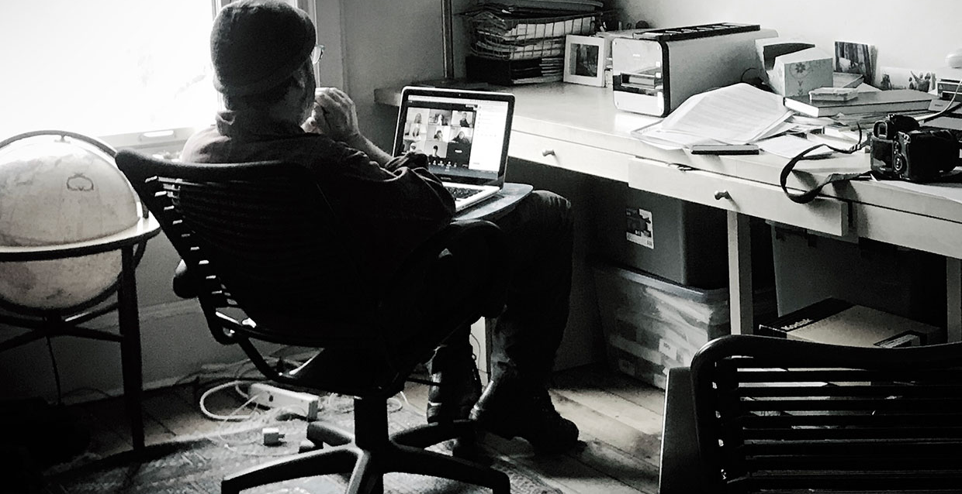
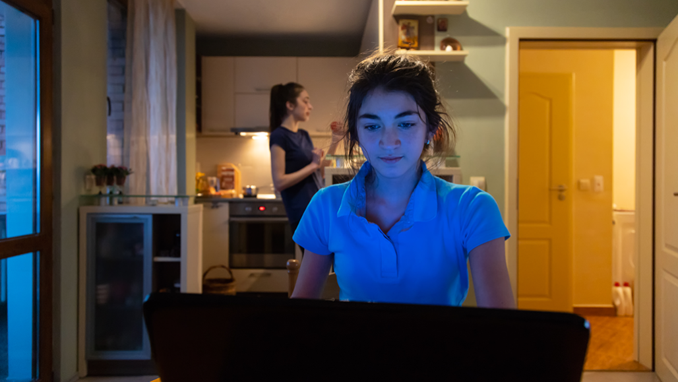
Home classroom = NOPE!
Isolated or in bedroom
Dark or minimal light (We could not see you if the camera needed to be on.)
Unsupervised (Could be doing anything)
Background noise from home environment
We can see things going on behind you.

Slide 7
Home classroom= YES!
Supervised
In a common area
It's easy to check on the student while doing other things.
Well-lit
We can see their faces in case the camera needs to be on.
Facing a wall or room partition
Nothing is happening behind them that will be seen on camera.
Calm
There are no distracting people or things in the space.
Keep it simple! Don't let Pinterest fool you.

Slide 8
Fifth Grade Mathematics
Mrs. McNabb’s Resource webpage http://wadsworthes.dekalb.k12.ga.us/SharonMcNabb.aspx
CURRICULUM OVERVIEW (See the syllabus on McNabb's Resource webpage)
Unit 1 – Order of Operations and Whole Numbers
Unit 2 – Decimals
Unit 3 – Fractions
Unit 4 – Measurement and Data
Unit 5 – Geometry
Communication: (Preference) Google Voice (678-632-3694) and Class Dojo. Please sign up for Class Dojo I sent an email invite.
Assignment: (Home Enrichment (HE), Class Assignment (CA), and materials are posted on Google Classroom (GC).
Interactive Math Notebook (IMN) is a composition notebook where students organize assignments and notes. They should maintain the Table of Contents (TOC) updates are posted on GC and glue and/or write information on the corresponding pages.
Grading: Check Infinite Campus at least weekly. Check the physical assignment on GC per assignments, Class Kicks per assignment... If you have questions concerning a grade, communicate it immediately. Please do not wait until a grade report.

Slide 9
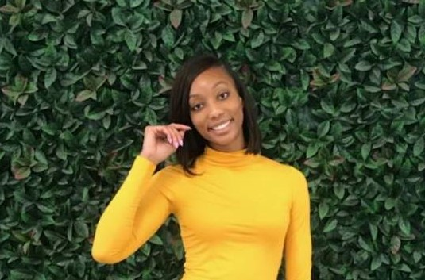
Welcome to 5th Grade ELA!
How do I get to class? ( TEAMs code or Outlook Calendar)
Student Reference Page (parent email, VERGE, TEAMs)
How do students access classwork and homework? (Assignment link -TEAMs)
How do I check my child's grades? (Infinite Campus)
I am Ms. Ariel Berry. The new 4/5th grade ELA teacher at Wadsworth Magnet School.
Incomplete & Missing Assignments
How do I contact the teacher?(Class Dojo, Email, TEAMs conference)
Curriculum Overview
Unit 1- Craft & Structure
Unit 2- Theme
Unit 3- Main Idea
Unit 4- Compare & Contrast
Unit 5- Integrating Information
Unit 6- Reasons & Evidence
What are digital small groups?
Student attendance (Microsoft Froms)

Slide 10
Fifth Grade SPANISH
CURRICULUM OVERVIEW (See the syllabus)
Unit 1 – School, Jobs, Professions
Unit 2 – Self
Unit 3 – Family and Home
Unit 4 – Stores and Shopping
Unit 5 – Body and Health
Live Teaching Sessions – Microsoft Teams
Live Teaching Interactions – Camera and mic off until instructed to turn on
Live Session Classwork Practice – Microsoft Teams
Assignments and Syllabus – Google Classroom
Communication: (Preference) email: Miriam_Natal@dekalbschoolsga.org, Remind App
Mrs. Natal’s webpage wadsworthes.dekalb.k12.ga.us/MiriamNatal.aspx

Slide 11
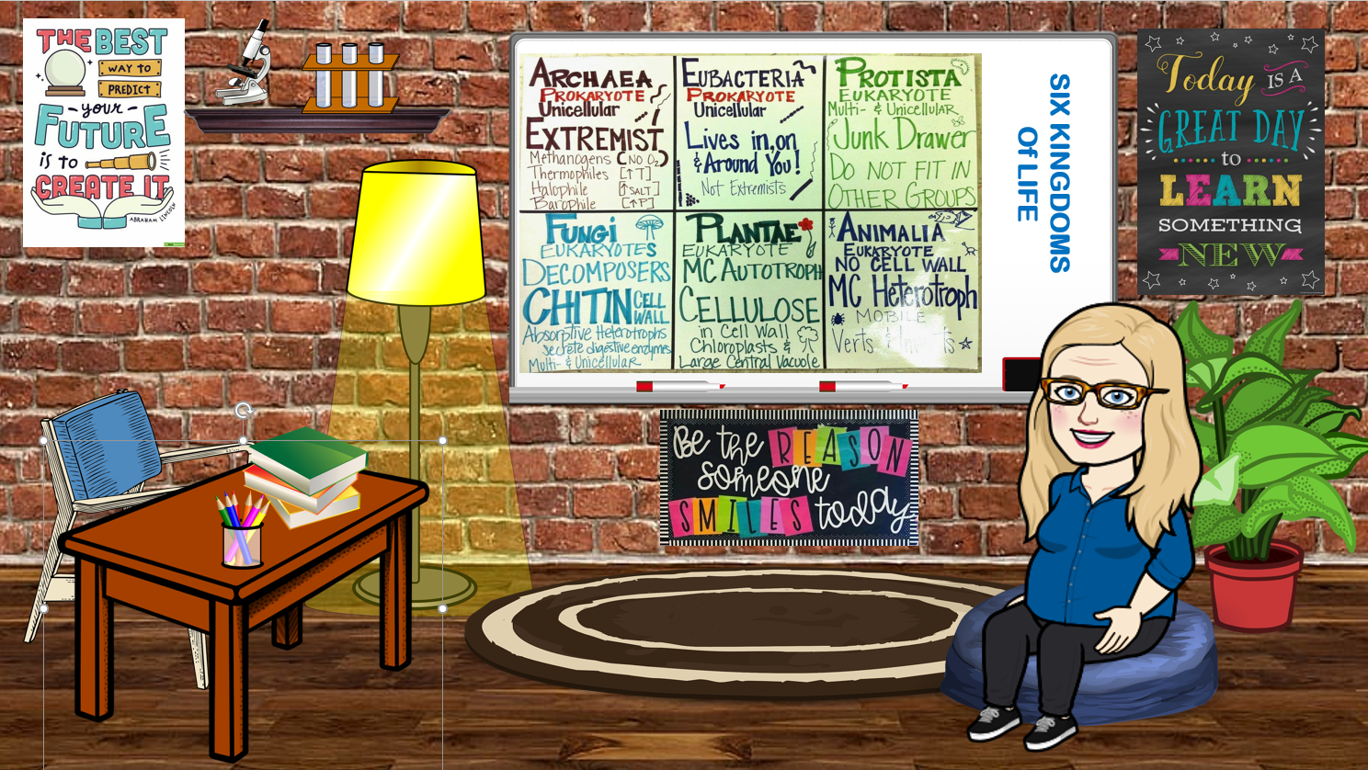
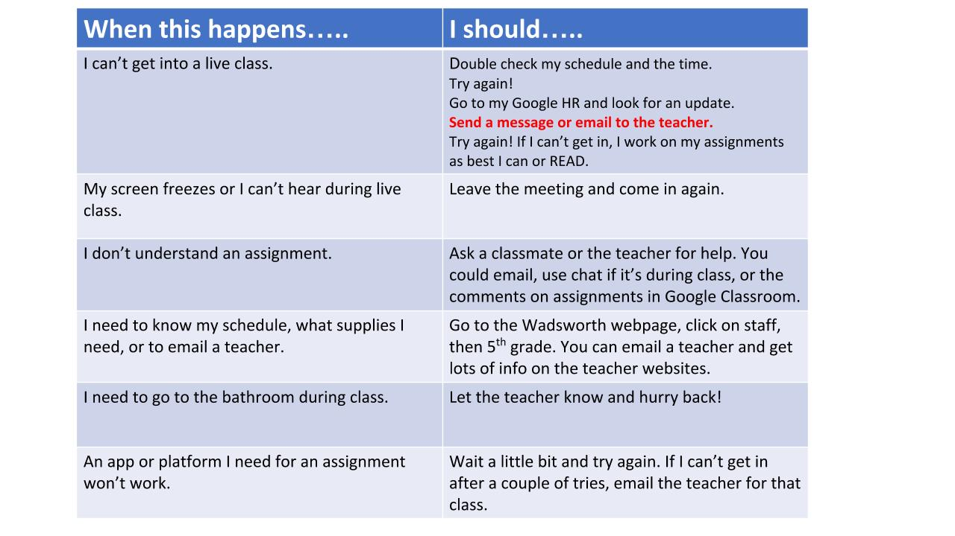
Fifth Grade science
Ms. Sanders
Office hours are Tuesdays 1:15-2:00, Wednesdays 1:00-2:00, and Thursdays 2:00-2:30.
Ms. Sanders' Webpage
CURRICULUM OVERVIEW
Unit1 – Classification
Unit 2 – Cells and Microorganisms
Unit 3 – Heredity
Unit 4 – Physical and Chemical Changes
Unit 5 – Earth Processes
Unit 6 – Electricity and Magnetism
Communication: Email is preferred, please.
Melissa_C_Sanders@dekalbschoolsga.org
Assignments: All assignments are posted in Google Classroom.
Interactive Resources: Stemscopes, Ed Your Friend In Learning, BrainPop, IXL, Quizlet
Grading: Check Infinite Campus at least weekly for grades and notes about missing/incomplete assignments.
Science Syllabus
If you have questions concerning a grade, communicate it immediately.
Please do not wait until a grade report.

Slide 12
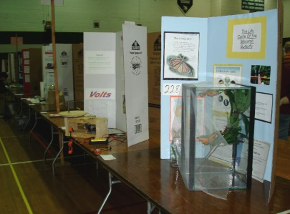
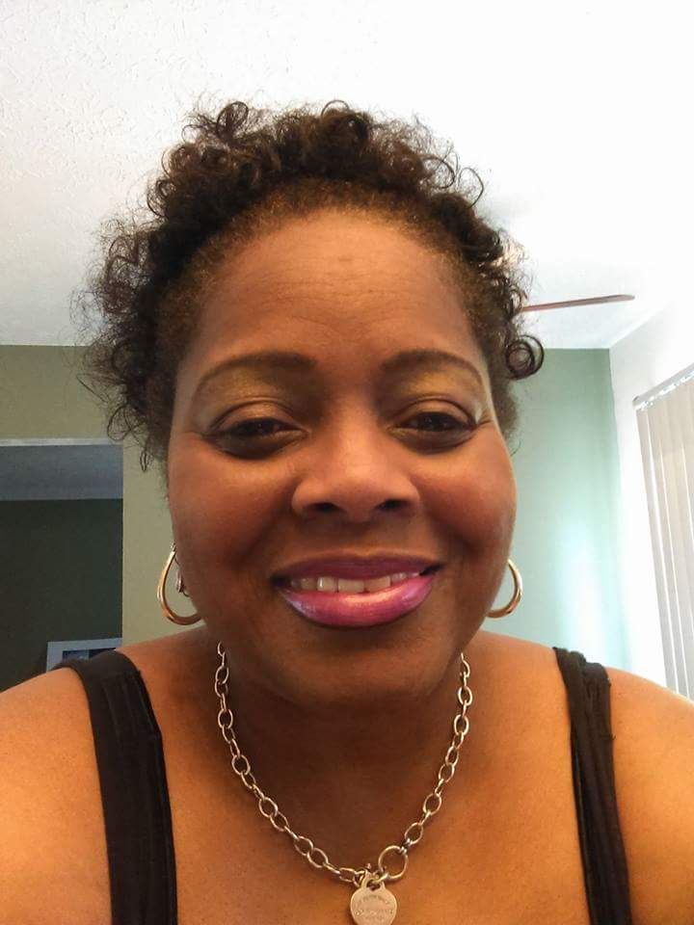
Welcome to 5th Grade Social Studies
Mrs. Roseberry 5th Grade
Curriculum Overview
Unit 1 American Life/ Turn of the Century | Unit 2 World War I/ Great Depression/ New Deal/ Harlem Renaissance | Unit 3 World War II | Unit 4 Cold War | Unit 5 Civil Rights/ Citizenship | Unit 6 New Developments
FAQ
How do I get to class? Teams or Verge
Social Studies Class Info-Teacher website, Verge, and Teams
How do students get homework?-Verge Classwork-Teams
How do I check my child’s grades-Infinite Campus
How do I contact the teacher? Email Hours 7-3(M-F) Conference by Appt-Wednesdays
When is attendance taken? A.M.

Slide 13
Troubleshooting
When this happens… | I should…
I can’t get into live class. | Double check the day, my schedule, and the time. Try again! Go to my Google HR and look for an update. Send a message or email to the teacher. Try again! If I can’t get in, I work on my assignments as best I can.
The teacher is not in the live class. | Go to the emergency assignments: Ms. Sanders – Google Classroom Mrs. McNabb – Google Classroom Mrs. Natal – Google Classroom Mrs. Berry – Teams Mrs. Roseberry - Verge
My screen freezes, or I can’t hear during live class. | Leave the meeting and come in again.
I don’t understand an assignment. | Message or email a classmate or the teacher and ask for help.
An app or platform I need for an assignment won’t work. | Wait a little bit and try again. If I can’t get in after a couple of tries, email the teacher for that class.
I need to go to the bathroom during class. | Let the teacher know and hurry back!
I need to know my schedule, what supplies I need, or to email a teacher. | Go to the Wadsworth webpage; click on staff, the 5th grade. You can email a teacher and get lots of info on the teacher websites.

Slide 14
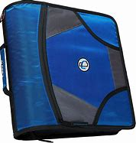
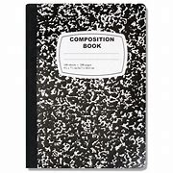
Supplies - 5th grade
Virtual Learning
Return to In Person Learning
County issued textbooks
Chromebook or other device
Printer with paper and ink
6 composition books. These should not be spiral bound.
Supply of pencils, 1 red pen, 1 blue
or black pen, 1 highlighter, notebook paper
Dry erase board (at least 12x12) and fine point dry erase markers, small eraser (old sock works well too)
Art supplies – scissors, bottled white school glue (not glue sticks) crayons or markers or colored pencils, 1 black Sharpie
County issued textbooks
Chromebook or other device
Printer with paper and ink
A 3 or 4 inch 3 ring zip up binder (2 in. is too small)
Materials to organize the binder; a 3-ring pencil pouch, 5 pocket dividers (if not built into the binder) Upon return to school in person, teachers will assist students with organizing binders.
Art supply container – no bigger than a typical shoebox, with the art supplies noted
Homeroom supplies – 3 boxes Kleenex, 1 ream white copy paper, 3 containers Clorox wipes, 1 large bottle hand sanitizer We understand these may not be available.
Other supplies may be needed depending on when we return to school.

Slide 15
Access to Learning
Clever, office 365, TEAMS, Verge, Google Classroom , and beyond

Slide 16
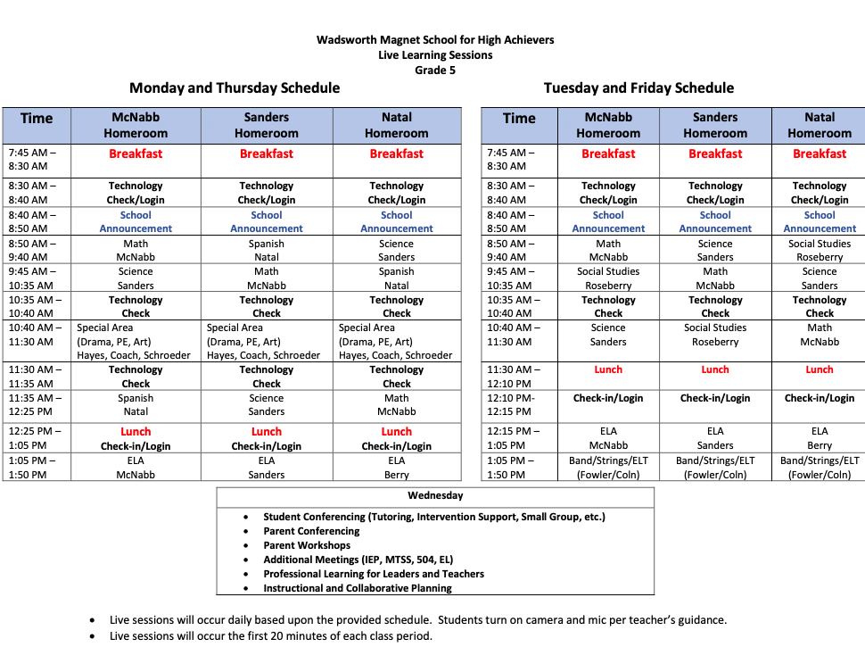
5th Grade Virtual Learning Schedules

Slide 17
Clever/Launchpad
How to access Clever
On a DCSD Chromebook:
Log into the Chromebook
Look for the Clever icon at the bottom of the screen ( the yellow rocket)
Click on the icon
You’re in!
On a personal device:
Go to clever.com
Click on “Log in as a student”
In the “Search for your school” box, type DeKalb County School District
Click on DeKalb County School District Dekalb, GA
Click “Log in with Active Directory”
A sign in box will open. Use your student email address as your username and your DeKalb grade level password 5th grade is dekalb05
Click “Sign in”
You’re in!
All DeKalb students have access to Clever, which you may be familiar with.
Clever allows students to access many platforms and learning apps without having to log in to each one individually.
Students on a DeKalb Chromebook will have a Clever/Launchpad icon at the bottom of their screen.
Once in Clever, students can access their student email, school Google account, Google Classroom and the apps and platforms needed for completing their assignments.

Slide 18
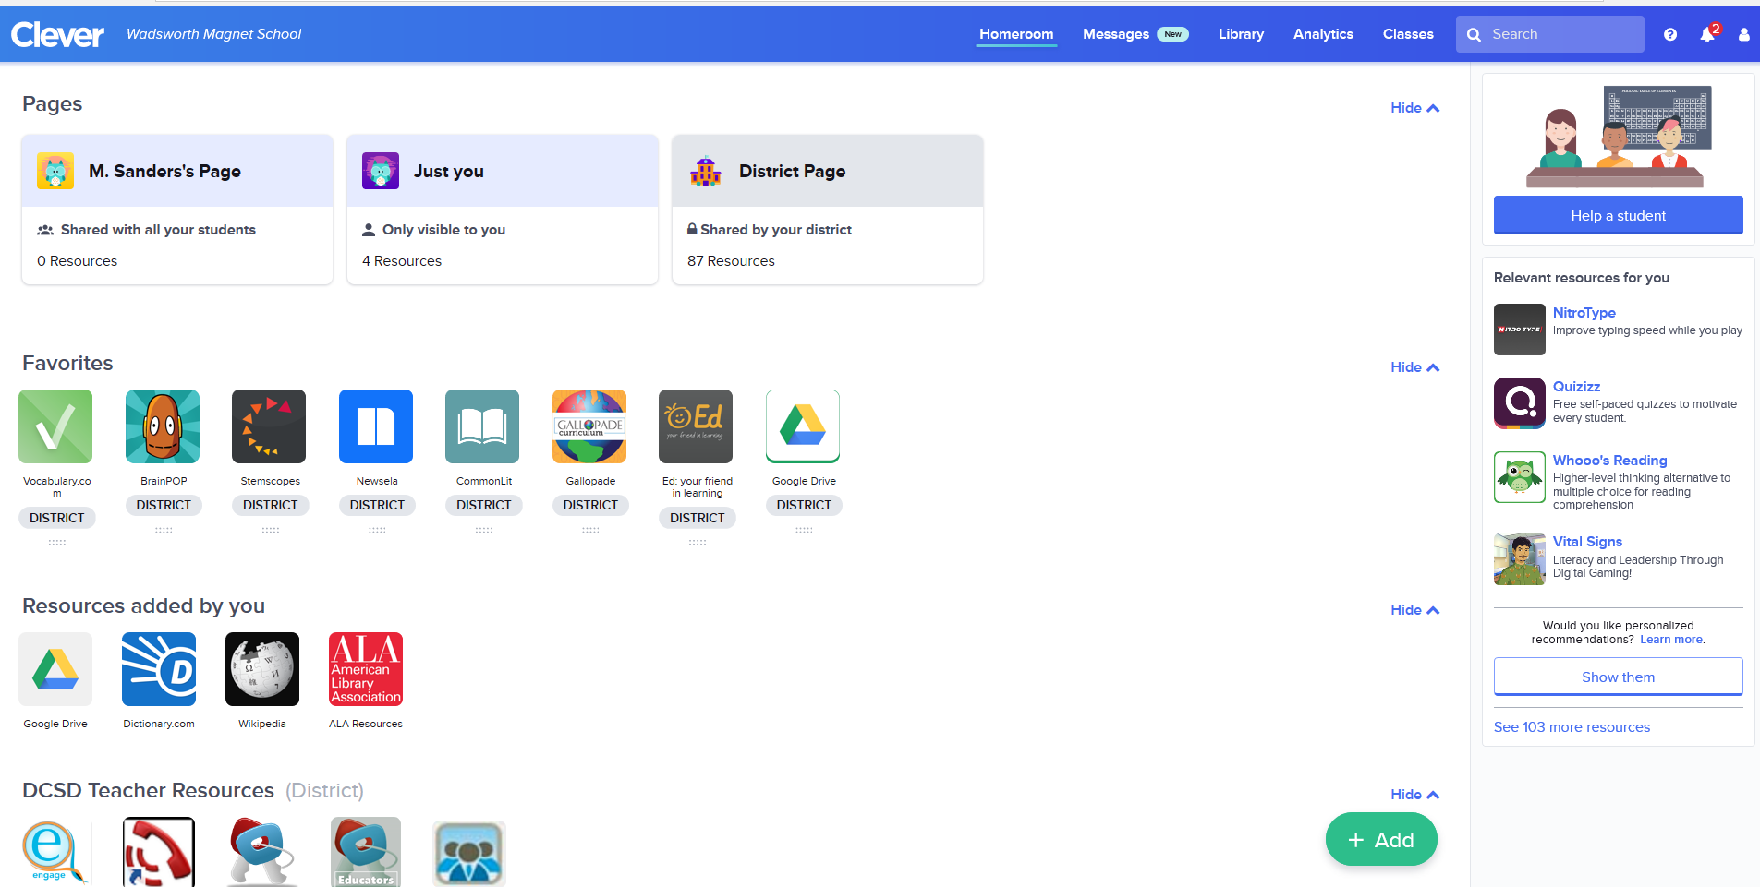

Slide 19
Verge/It’s Learning
All DeKalb students have access to Verge, which you may remember from last spring.
Verge is a platform that allows teachers to post announcements, and assignments.
Students can submit work through Verge, as well as message their teachers.
Students on a DeKalb Chromebook will have a Verge icon at the bottom of their screen that will put them right into Verge.
Students can also access Verge through Clever.

Slide 20
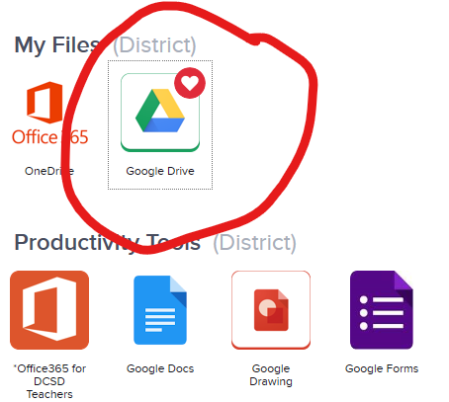
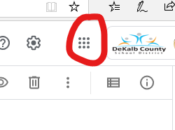
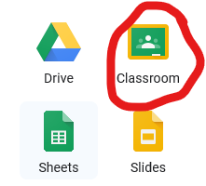
Going to Google Classroom
Go into Clever.
Scroll down and find the Google Drive icon; click it.
From Google Drive, click on the waffle in the top right corner.
Click on the green Classroom icon.
You will see all the Google Classrooms you to which you belong. Click on a classroom to open it.

Slide 21
Access to Communication
Ways to stay in touch

Slide 22
A note on communication
Communication flows TWO WAYS.
You have to reach out to the school as often as you expect the school to touch bases with you.
Make sure that all your contact information with the school is correct.
Keep an open mind about the various ways you can keep in touch.
Make it simple and continuous.
Yes, you can do it, even if you're "very busy" or "not good with computers".
Take initiative to understand what's going on in the classes and what your student is being asked.
There is no need to wait for the teacher to tell you anything.
Take the bull by the horns.
START RIGHT NOW.
Take out your phone so that you can follow instructions.

Slide 23
Infinite Campus
Infinite Campus is the system we use to enter grades and attendance.
Immediate grade updates!
There's an app!
Both students and parents can log in.
Students: Use your s# and your Chromebook login.
Parents: You have to create an account.
Having trouble? Contact Mrs. Lynch or Dr. Jones for help.

